Slide 1
CALENDAR

Slide 2
Introduction
Concept of odd days
Leap and non-leap years and centuries
Same calendar concept
Finding day on a given date
Miscellaneous questions

Slide 3
Counting odd
Odd days in an ordinary year: An ordinary year contains 365 days. On dividing 365 by 7, we get 1 as a remainder (52*7 +1) or (52 weeks + 1 day). It means an ordinary year has one odd day.
Odd days in a leap year: A leap year contains 366. On dividing 366 by 7, we get 2 as remainder (52*7 + 2) or (52 weeks + 2). It means a leap year has two odd days.
Odd days in a century: A century has 76 ordinary years and 24 leap years.
∴100 years = 76 ordinary years + 24 leap years
= [(76*52) weeks + 76 odd days] + [(24*52) weeks + 48 odd days]
= [(100*52) weeks + 124 odd days]
= (5200 weeks + 17 weeks + 5 odd days)
= (5217 weeks + 5 odd days)
∴A century or 100 years have 5 odd days.
Similarly, in 200 years, there will be 10 (5+5) days, 7 days (1 week) + 3 odd days. So, 200 years have 3 odd days.

Slide 4
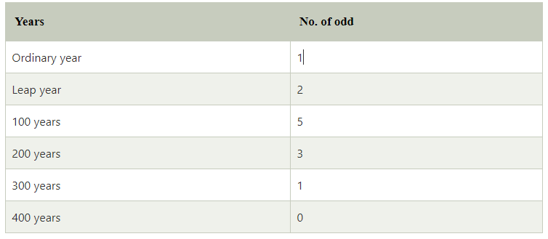
Tables of odd
a.) Table showing the relation between the year and the number of odd

Slide 5
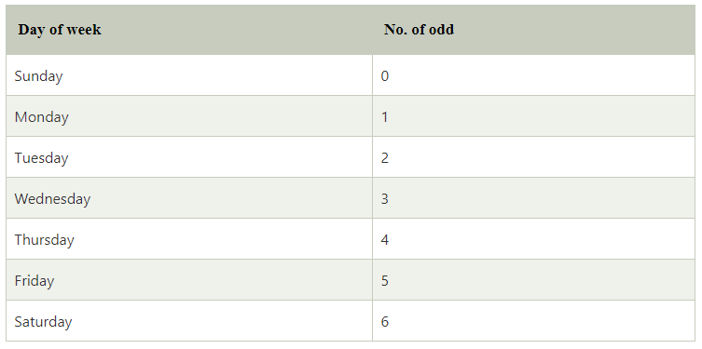
b.) Table showing the relation between the day of the week and the number of odd

Slide 6
Points to remember:
1. Problems on calendar mainly deal with finding the day of the week on a given date using the number of odd days.
2. Odd days: Odd days are different from odd numbers. They are the number of days more than the complete number of weeks in a given period.
3. To find the number of odd days divide the given number of by seven. The remainder left represents the number of odd days.
For example: if the given number of days is 80, after dividing 80 by 7, the remainder left is 3. Hence, there are three odd days.
Similarly, if the given number of days is 77, after dividing 77 by 7, the remainder left is 0. Hence, there are 0 odd days.
4. Ordinary year: A year which is not a leap year is called an ordinary year. It has 365 days.
5. Leap year: A year which is divisible by 4 is called a leap year, e.g. 1992, 1996, 2000, etc., are leap years. A leap year has 366 days. If the year is a century, it will be a leap year if it is divisible by 400, i.e. every 4th century is a leap year, e.g. 400, 800, 1200, etc., but 200, 500, 1900, etc., are not leap years.

Slide 7
1.What is two weeks from today?
A]Same day B] Previous day
C] Next day D] None
Notes:
Option A) same day
Easy (Compulsory)

Slide 8
2.How many days are there in k weeks k days ?
A]8+K DAYS B] 7+K DAYS
C] 8K DAYS D] 7/K DAYS
Notes:
Option C
Easy (Compulsory)

Slide 9
3. How many weekends in a non-leap year?
A] 52 B] 53
C] 103 D] 104
Notes:
Answer: A) 52
Easy (Optional)

Slide 10
4. What is the number of odd days in a leap year?
A] 1 B] 2
C] 3 D] 4
Notes:
Option B
Easy (Optional)

Slide 11
5.If the third day of a month is Tuesday, which of the following would be the 25th day of that month?
A] Tuesday B] Monday
C] Wednesday D] Sunday
Notes:
Answer: C) Wednesday
Easy (Compulsory)

Slide 12
6. Today is Wednesday, What will be the day after 27 days?
A] Monday B] Wednesday
C] Friday D] Tuesday
Notes:
Option D
Easy (Optional)

Slide 13
7. Today is Wednesday, What will be the day after 62 days?
A] Monday B] Wednesday
C] Friday D] Tuesday
Notes:
Option D
Easy (Compulsory)

Slide 14
8. Arnav's birthday is on Tuesday 14th March. On what day of the week will be Pranay's Birthday in the same year if Pranay was born on 13th September?
A] Monday B] Tuesday
C] Wednesday D] Thursday
Notes:
Option C
Moderate (Compulsory)

Slide 15
9. Aniruddh's birthday is on Sunday 2nd April. On what day of the week will be Priyansh's Birthday in the same year if Priyansh was born on 28th October??
A] Saturday B] Wednesday
C] Friday D] Thursday
Notes:
Option A
Moderate (Optional)

Slide 16
10. Priya's birthday is on Tuesday 11th April. On what day of the week will be Rani's Birthday in the same year if Rani was born on 31st August?
A] Monday B] Wednesday
C] Tuesday D] Thursday
Notes:
Option D
Moderate (Optional)

Slide 17
11.If Feb 12th,1986 falls on Wednesday then Jan 1st,1987 falls on which day?
A] Wednesday B] Tuesday
C] Thursday D] Friday
Notes:
Answer: C) Thursday
Moderate (Optional)

Slide 18
12.If 6th March, 2005 is Monday, what was the day of the week on 6th March, 2004?
A] Sunday B] Saturday
C] Tuesday D] Wednesday
Notes:
Answer: A) Sunday
Moderate (Compulsory)

Slide 19
13.Given that on 9th August 2016 is Saturday. What was the day on 9th August 1616 ?
A] Saturday B] Sunday
C] Friday D] Monday
Notes:
Answer: A) Saturday
Expert (Compulsory)

Slide 20
14.The maximum gap between two successive leap year is?
A]4 B]8
C] 2 D]1
Notes:
Answer: B) 8
Easy (Compulsory)

Slide 21
15. Which of the following is not a leap year?
A] 800 B] 900
C] 1600 D] 2400
Notes:
Option B
Easy (Optional)

Slide 22
16. How many leap years are there in 160 years?
A] 80 B] 90
C] 39 D] 40
Notes:
Option C
Moderate (Compulsory)

Slide 23
17. How many leap years are there in between 2000 to 2160 years?
A] 80 B] 90
C] 39 D] 40
Notes:
Option D
Moderate (Optional)

Slide 24
18. How many leap years are there in 900 years?
A] 218 B] 217
C] 225 D] 223
Notes:
Option A
Expert (Optional)

Slide 25
19.The last day of a century cannot be
A] Tuesday B] Saturday
C] Thursday D]All of the above
Notes:
Answer: D)
Expert (Compulsory)

Slide 26
21. Which of the calendars would be same as that of the year 1907?
A] 1918 B] 1917
C] 1915 D] 1916
Notes:
Option A
Moderate (Compulsory)

Slide 27
22. Which of the calendars would be same as that of the year 1965?
A] 1970 B] 1971
C] 1972 D] 1973
Notes:
Option B
Moderate (Optional)

Slide 28
23. Which of the calendars would be same as that of the year 2028?
A] 2056 B] 2057
C] 2058 D] 2059
Notes:
Option A
Moderate (Compulsory)

Slide 29
24. Which of the calendars would be same as that of the year 2032?
A] 2002 B] 2003
C] 2004 D] 2005
Notes:
Option C
Moderate (Optional)

Slide 30
25. What was the day of the week on 20th May, 2007?
A] Sunday B] Monday
C] Tuesday D] Wednesday
Notes:
Option A
Moderate (Compulsory)

Slide 31
26. What was the day of the week on 20th April, 1806?
A] Sunday B] Monday
C] Tuesday D] Wednesday
Notes:
Option A
Moderate (Compulsory)

Slide 32
27. What was the day of the week on 01st Jan, 1996?
A] Sunday B] Monday
C] Tuesday D] Wednesday
Notes:
Option B
Moderate (Optional)

Slide 33
28.On what dates of April, 2001 did Wednesday fall?
A] 2nd ,9th ,16th ,23rd B] 4th ,11th ,18th ,25th
C] 12th ,18th ,27th ,6th D] 1st ,8th ,15th ,22nd
Notes:
Answer: B) 4th,11th,18th,25th
Expert (Compulsory)

Slide 34
29. If every seconds Saturday and all Sundays are holidays in a 30 days month beginning on Saturday, then how many working days are there in that month ? (Month starts from Saturday)
A] 25 B] 24
C] 22 D] 23
Notes:
Answer: D) 23
Moderate (Compulsory)

Slide 35
30.Second & fourth Saturdays and every Sunday is a holiday. How many working days will be there in a month of 31 days beginning on a Friday ?
A] 24 B] 23
C] 22 D] 25
Notes:
Answer: A) 24
Moderate (Compulsory)

Slide 36
Any Doubts???

